Slide 1
Research Coordination, Scientific Community Outreach, Education & Public Outreach
Pamela S. Soltis
Co-PI & iDigBio Director for Research
FLMNH, University of Florida
Bruce J. MacFadden
Co-PI & iDigBio Director of Education and Outreach
Curator of Vertebrate Paleontology, FLMNH

Slide 2
Digitization of Biodiversity Collections Data Interactive, Integrative, Innovative
Components of iDigBio:
Cyberinfrastructure
Digitization
Research
Education and Outreach
Each component offers opportunities
for community engagement.
Notes:
These are the 4 key components of iDigBio. One of the goals is for digitization efforts to enable and facilitate new research in a number of new and creative ways.

Slide 3
Digitization of Biodiversity Collections Data Interactive, Integrative, Innovative
Part 1. iDigBio Research
Research
Access to specimen data: Provide portal access to biodiversity data in a cloud-computing environment
Development of a computational environment to facilitate specimen-based integrative biodiversity research
Cyberinfrastructure
Digitization
Education and Outreach
Notes:
The driving force behind ADBC is research, and there are 2 major ways in which iDigBio is working to enable new research: first through access to specimen data through the portal, and second through development of a computational environment that will facilitate specimen-based integrative biodiversity research.

Slide 4
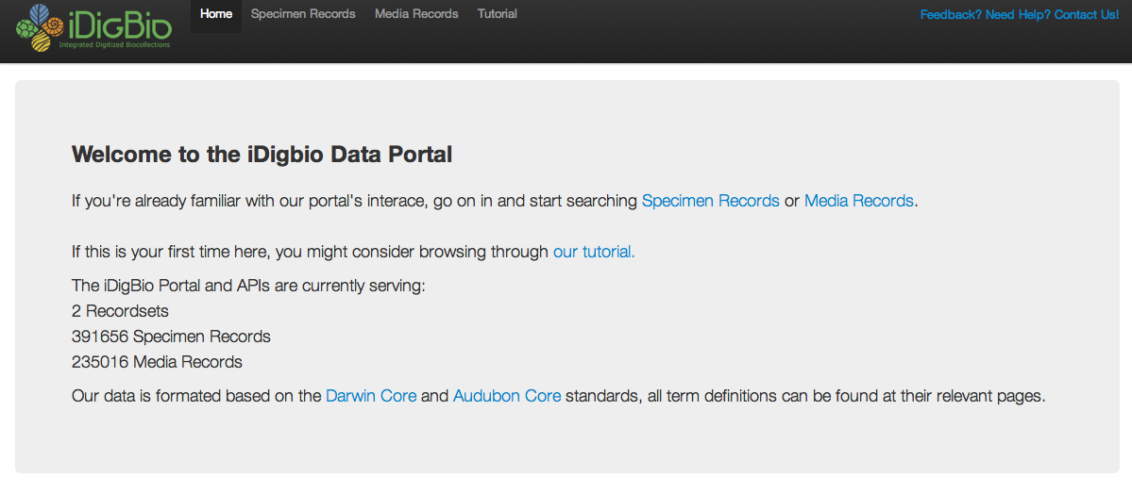
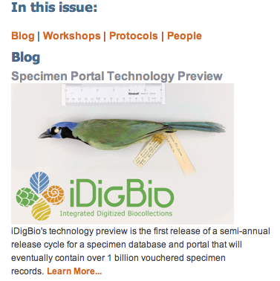
iDigBio Data Portal
Notes:
As you will hear in the talk from Jose, development of the specimen data portal is underway. The goal is that this portal will eventually provide access to digitized data for US museum collections, with principal emphasis on non-federal specimens.

Slide 5
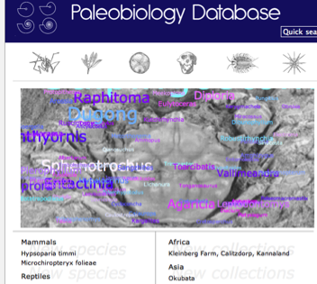
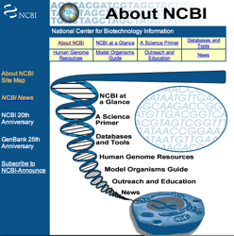
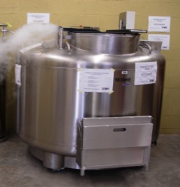
Linking Collections to…
Ecology
Paleontology
Genomics
Living Collections
Other repositories
Notes:
Even as construction of the portal is occupying the majority of the effort of the CI team, we are looking toward the needs of the research community. Biodiversity research will be linked to a number of other data sources, from ecology to genomics. And although there is now a presence of paleontology in ADBC, we hope to continue to expand this presence with links to other data sources.

Slide 6
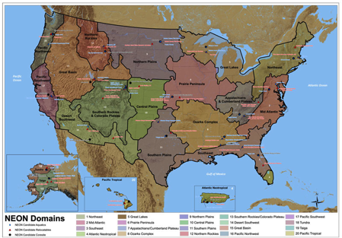
Linking Collections to Ecology
Through NEON
Biological monitoring at sites across USA; collections
Baseline for changes in
species distribution and
abundance over time
National Ecological Observatory Network
Notes:
Links to ecological data will be made through NEON, the National Ecological Observatory Network, which provides both biological monitoring (and hopefully collections) and climate data for sites across the US. Data from NEON could provide a baseline for changes in species distribution and abundance over time.

Slide 7
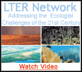
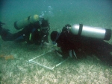
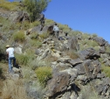
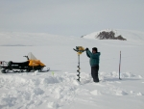
Linking Collections to Ecology
Through collections from LTERs
Notes:
NSF’s Long-Term Ecological Research sites also have data that could be useful in combination with biodiversity data served by iDigBio.

Slide 8
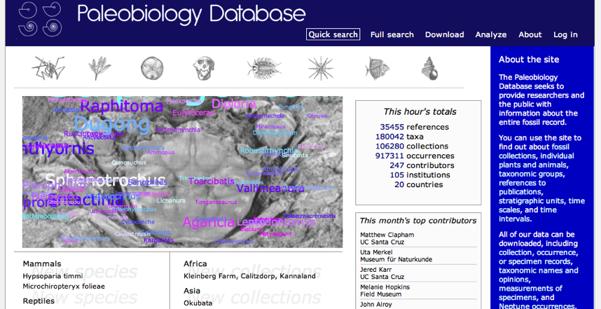
Linking Collections to Paleobiology
Paleobiology Database
(http://paleodb.org/cgi-bin/bridge.pl)
Notes:
Various paleo resources are also available for linking with specimen collection data, both paleo and neo.

Slide 9
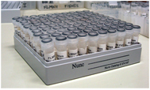
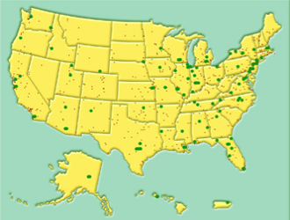
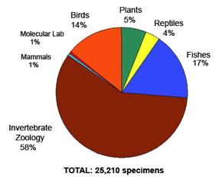
Linking Collections to Genomics
National network of tissue and genetic
resources
Notes:
And many opportunities exist for linking collections with genetic and genomic resources and data. One of our goals for this year is to further the establishment of a national network of tissue and genetic resources, and we are collaborating with other groups and collections to this end.

Slide 10
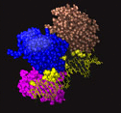
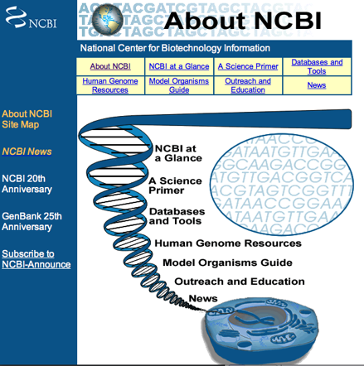
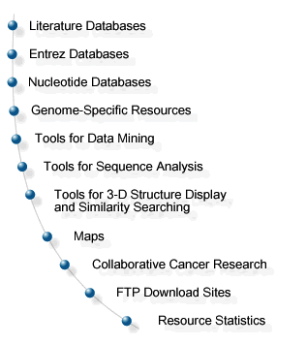
Linking Collections to Genomics
Extend HUB connections to genomics databases
Notes:
Likewise, we will want to be able to link specimen data to corresponding sequences and other data in GenBank.

Slide 11
Linking to Living Collections
Botanical gardens, zoos, culture collections
Notes:
And of course linking to data in living collections, from fungi, zoos, algae, and botanical gardens.

Slide 12
Digitization of Biodiversity Collections Data Interactive, Integrative, Innovative
Components of iDigBio:
Research
Access to specimen data: Provide portal access to biodiversity data in a cloud-computing environment
Development of a computational environment to facilitate specimen-based integrative biodiversity research
Cyberinfrastructure
Digitization
Education and Outreach
Each component offers opportunities
for community engagement.
Notes:
Development of the computational environment for doing these sorts of integrated analyses presents challenges of its own, so we are currently developing sample workflows that will help to identify the requirements for this sort of environment.

Slide 13
What Makes iDigBio Unique?
Ingest all contributed data with emphasis on GUIDs, not just a restricted set of selected data elements
Maintain persistent datasets and versioning, allowing new and edited records to be uploaded as needed
Ingest textual specimen records, associated still images, video, vocalizations, and other media
Ingest related linked documents and associated literature, including digitized field notes, ledgers, monographs, journal articles, gray literature, related collections, etc.
Provide virtual annotation capabilities and track these annotations back to the originating collection
Notes:
We at iDigBio are often asked, “What makes iDigBio unique?” We think there are several key elements, but from the research perspective…

Slide 14
What Makes iDigBio Unique?
Ingest all contributed data with emphasis on GUIDs, not just a restricted set of selected data elements
Maintain persistent datasets and versioning, allowing new and edited records to be uploaded as needed
Ingest textual specimen records, associated still images, video, vocalizations, and other media
Ingest related linked documents and associated literature, including digitized field notes, ledgers, monographs, journal articles, gray literature, related collections, etc.
Provide virtual annotation capabilities and track these annotations back to the originating collection
Integrate across data sets
Research and computational environment
Notes:
iDigBio will allow us to integrate across data sets – for example, the Florida plant project could be done for fish, birds, butterfiles, etc. (and it is).
In addition, iDigBio will provide the computational environment to allow this sort of project (and others) to be conducted in a streamlined fashion.

Slide 15
Research Activities for Year 2
Continuing discussions with other data sources
Working toward an integrated national network of genetic resources
Survey of genetic collections to assess needs, capabilities, etc.
workshop in January
Development of sample research workflows using specimen data to enable development of a computational environment for integrated research
NESCent-hosted workshop on linked data - spring
A workshop and working group on research needs
Notes:
Here are listed the research-related activities that are underway for year 2.

Slide 16
Research Workshop and Working Group
Planning stages
Which data sources? Contacts?
Workflow design: what is needed to enable complex workflows using specimen data?
Discussion in Birds of a Feather session later today
Further discussion tomorrow during “Collaboration” break-out session
If interested in participating in a workshop and working group focusing on research needs, see Pam
Notes:
With regard to the last point, we are in the early stages of developing a research working group, and we are planning for a research workshop. [please list these items and point out Birds of a Feather and the break-out session]

Slide 17
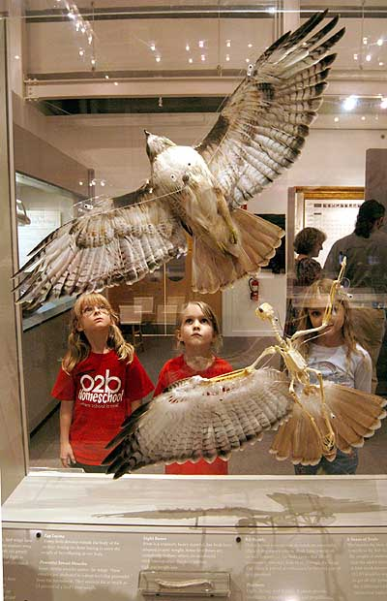
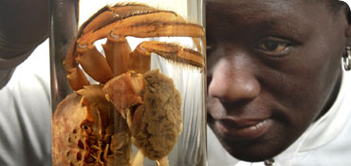
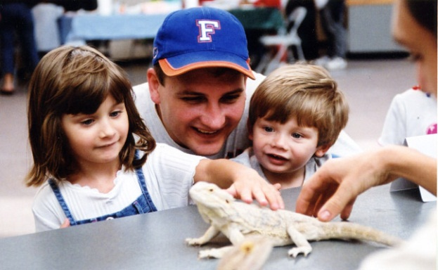
Part 2. Education & Outreach (E&O) and Evaluation

Slide 18
iDigBio E&O framework has followed NSFs Broader Impact criteria**
Advance discovery and understanding while promoting teaching, training, and learning
Broaden participation of underrepresented groups
Enhance infrastructure for research and education
Broad dissemination to enhance scientific and technological understanding
Benefits to Society
*http://www.nsf.gov/pubs/2007/nsf07046/nsf07046.jsp

Slide 19
(NSFs BI criteria are changing soon!)
From new GPG: 1. Merit Review Principles
…
“NSF projects, in the aggregate, should contribute more broadly to achieving societal goals. These broader impacts may be accomplished through the research itself, through activities that are directly related to specific research projects, or through activities that are supported by, but are complementary to, the project. The project activities may be based on previously established and/or innovative methods and approaches, but in either case must be well justified….”

Slide 20
iDigBio E & O activities so far
University community & target audiences
iDigBio Visiting scholars program
Workshops focused on E&O (Public Participation), or others with E&O content (e.g., Paleocollections Workshop)
Developing complementary partnerships (e.g., with societies)
Seeking additional sources of funding to supplement iDigBio E&O capacity.

Slide 21
Engaging the university community: training the next generation
Involving graduate students, postdocs, and undergraduates in iDigBio related activities, for example:
Plant molecular lab (Soltis lab)
Digital paleontology (MacFadden et al.)
Cyberinfrastructure (Fortes, etc.)
Ichthyology, digitization of slides (Page)
Involved in iDigBio workshops
Plans for a student focused workshop (Deb Paul, et al.)

Slide 22
Engaging the scientific community
Seminars that promote, or discuss activities and outcomes of iDigBio
iDigBio-sponsored workshops that have some E&O content or as central fcous
Mast and Dunckel; Public Participation Workshop (Sept 2012)
Sponsor symposia and workshop-style formats at national meetings (e.g., Botany 2012; SPNCH 2013, etc.)

Slide 23
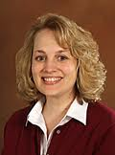
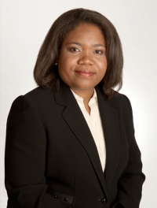
Broadening representation iDigBio Visiting Scholars program
2012, Anna Monfils, Central MI Univ
2013 Corey Toler—Franklin, UC-Davis
Target audience, early career professional development
$25,000, up to 3 months of stipend + travel
Program seeks more applications in next cycle!

Slide 24
E&O activities—future opportunities and possible activities
iDigBio cannot do it all; not our role
Looking for leadership among TCNs
Teach UG/G courses about digital biodiversity, etc.
Lead webinars, etc.
Lead working iDigBio working group and host workshop
Late 2013 E&O Workshop to integrate and coordinate BI & E&O-related activities

Slide 25
Analysis TCN BI activities (N=7)* (if explicitly stated)
Grad training & mentoring 6
Undergraduate training & mentoring 6
Postdoc training & mentoring 2
Fostering professional community use 1
Museums, etc. 5
K12 outreach 4
Underrepresented groups 5
Amateurs, volunteers & citizen science 5
Evaluation & Best Practices 2
EPSCoR 1
Access & awareness of digitized collections by society 1+
*Thanks to Joanna McCaffrey for help

Slide 26
TCNs’ BI general overview
Many proposed BI projects have limited accountability for goals, outcomes, etc.
Some activities complement iDigBio initial goals; e.g., developing an UG course, webinar etc.
Lots of overlap and possibility for collaborations
And possible funding from from other NSF programs
Coordination and communication—via E&O workshop
Also—
Encourage to connect with Public Participation Working group
Propose to develop a working group, e.g., K12 outreach

Slide 27
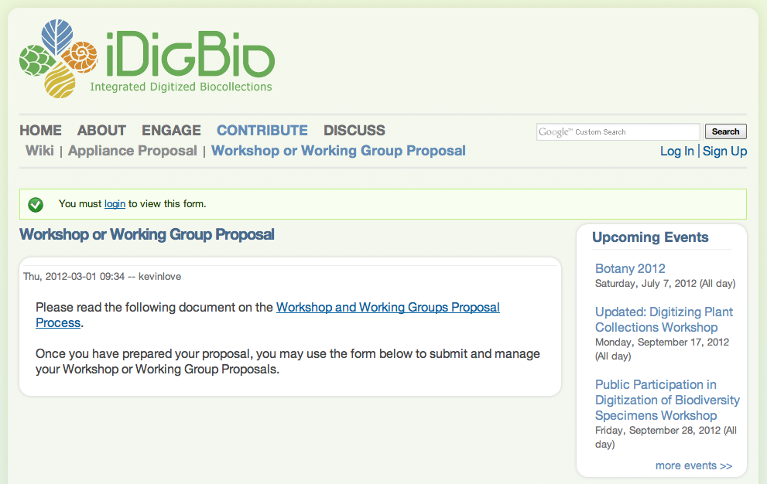
Workshop/Working Group Proposal Process
Notes:
In addition, if participants have ideas for specific research-related workshops or working groups, we invite you to submit a proposal through the iDigBio website.

Slide 28
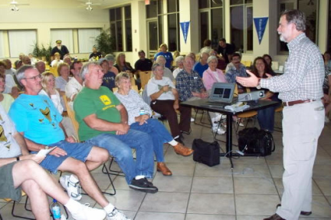
iDigBio Paleo Outreach
Fossils in the Cloud—talks to fossil clubs in Florida about iDigBio, digitized fossils, etc.
Perceived great interest in concept
Practical need
NSF “FOSSIL” pre-proposal submitted to Advancing Informal STEM Learning program
Link up to 50 fossil clubs in US
Provide “Citizen Development” (~PD) so that some can help with digitization

Slide 29
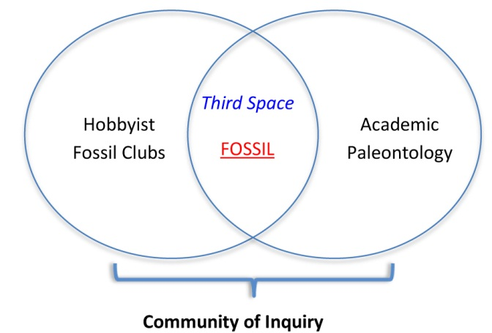
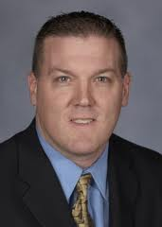
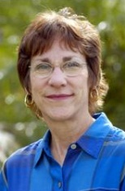
FOSSIL project, continued
More closely link citizen and professional paleontologists in virtual Third Space via a Community of Inquiry
Send out front-end needs survey to US fossil clubs (Oct/Nov 2012)
The data will inform us about how fossil clubs want to engage with iDigBio, TCNs, etc.
Serve as Best Practices for other down-stream user groups, i.e., hobbyists, clubs, etc.
Learning research
Competition, gaming, and cyber engagement (Krippen)
“Value” of real v. digital objects to public (Dunckel)

Slide 30
Future: We (TCNs and iDigBio) need to continue to identify target additional audiences, interest, and user groups for E&O
Collection researchers and other professionals
Other non-federal collections networks
University students and others in community
Government agencies, Policy makers
Industry and business innovation
Downstream users and other stakeholders: K12, 4H, interest groups and clubs, etc.

Slide 31
Overall ADBC Goals 2020 related to E&O
Remove natural history specimens from the realm of Dark Data--
to greatly increase access for downstream users
Resulting in an increased overall benefit and value to society
From a funded TCN proposal---
“greater use and appreciation of scientific collections by non-scientists through unprecedented access to specimen images and label data”

Slide 32
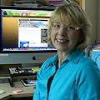
Evaluation
Professional evaluator, Dr. Shari Ellis, FLMNH’s Center for Informal Science Education
Develops surveys, interviews, and evaluates workshops and other iDigBio activities
Collects and provides data for annual reports, as needed
Overall project evaluation
Process during early stages
Impacts and outcomes during later stages
Will track goals, milestones, deliverables, outcomes, etc.

